Slide 1
DIPARTIMENTO DI INGEGNERIA ELETTRICA E TECNOLOGIE DELL’INFORMAZIONE
SCUOLA POLITECNICA E DELLE SCIENZE DI BASE
MASTER’S COURSE IN AUTOMATION ENGINEERING AND ROBOTICS
Field and Service Robotic Project
Geometric Tracking Controller and APF Planner
Pasquale Costanzo
P38/44

Slide 2

SOMMARIO
Description of the scene
Description of the simulation
Artificial Potential Planner
Geometric Controller
Simulation

Slide 3
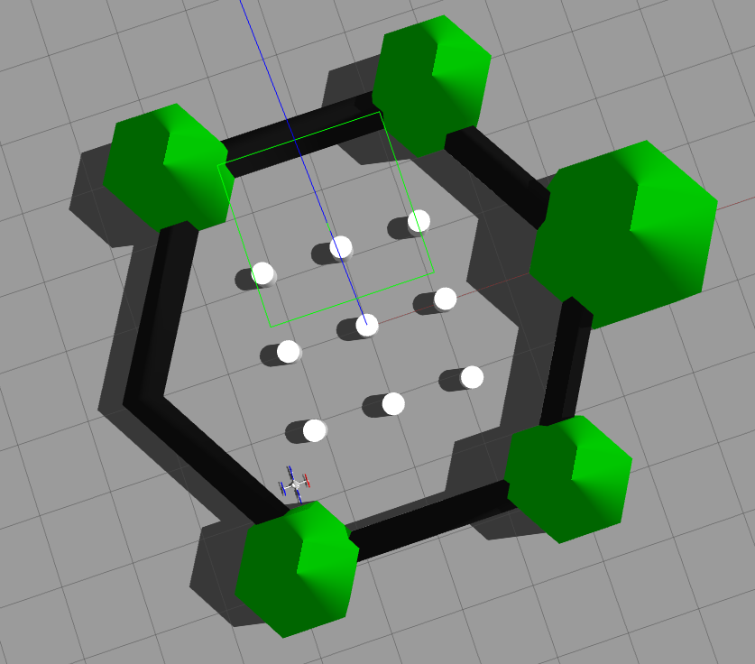
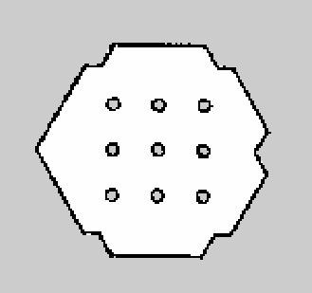
Description of the scene
Robots employed:
Hummingbird
Sensors Used:
IMU
The arena have static object.
I create a map with turtlebot3 and gmapping. The map is in 2D

Slide 4
Description of the simulation 1/2
Phase 1:
The map_server node loads the previously created map on the /map topic.
Phase 2:
The planner will read the map from the /map topic and position from odometry on topic hummingbird/ground_truth/odometry. There will always be an attractive force trying to bring it to the desired position. In case there is an obstacle around the drone, a repulsive force will be added to the attractive force. The planner publishes on the topic hummingbird/command/trajectory with frequency 1000hz

Slide 5
Description of the simulation 2/2
Phase 3:
The controller read on topic hummingbird/command/trajectory. the trajectory with 1000 frequency.
The rotor velocities are published on hummingbird/command/motor_speed.
If we are near the final position the planner send the final position to the tracking controller.

Slide 6
Artificial Potential Planner
Attraction Force:
$$f_{a}=K_{a}(p-p_{d})$$
Repulsion Force:
If the obstacles is near drone (distance lesser 0.3),we add the repulsive forces with this formula:
$$f_{r}=f_{r}+\frac{k_{r}}{d^{2}}(\frac{1}{d}-\frac{1}{r})$$
In the topic if the value are -1 we don’t know if there are a osbtacles, if the value is 0 is free and if value are 1-100 , there are a obstacles.
For trajectory i don’t transfrom the force in velocities or other, i transfrome force in near position. This isn’t the perfect choice but is functional for testing geometric controller. The drone avoide the obstacles.
The map is in 2D, so where is the obstacles the quadrotor don’t go in z axis.
$$p_{sent}=\frac{0.{2f}_{t}}{||f_{t}||}+p$$

Slide 7
Geometric Controller 1/2
Initially the controller read position and desired trajectory from the topics:
/hummingbird/command/trajectory
/hummingbird/ground_truth/odometry.
After I followed Lee's paper[1]. So initially I calculated$${ b}_{3d}$$ from equation (12) [1]
Then I compute $${ Proj(b}_{1d})$$ :
$$\left[\cos\left({yaw}_{d}\right) \sin\left({yaw}_{d}\right) 0\right]$$
And finally I calculate $$b_{2d}$$ and $$b_{1d}$$
Now I have the rotation matrix so using the formula (15) and (16) from [1] for calculate total thrust and torques.

Slide 8
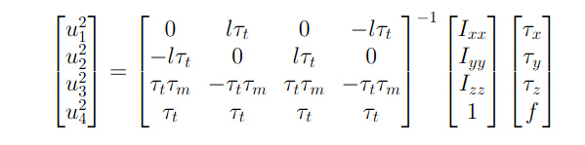
Geometric Controller 2/2
Afterwards I transformed the total thrust and torques into rotor speeds :
After the velocities were published on:
hummingbird/command/motor_speed

Slide 9
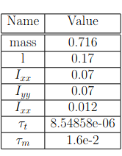
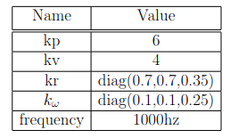
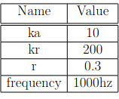
Simulation 1/4
Hummingbird parameter
Controller parameter
Artifical Potentintial Planner parameter

Slide 10
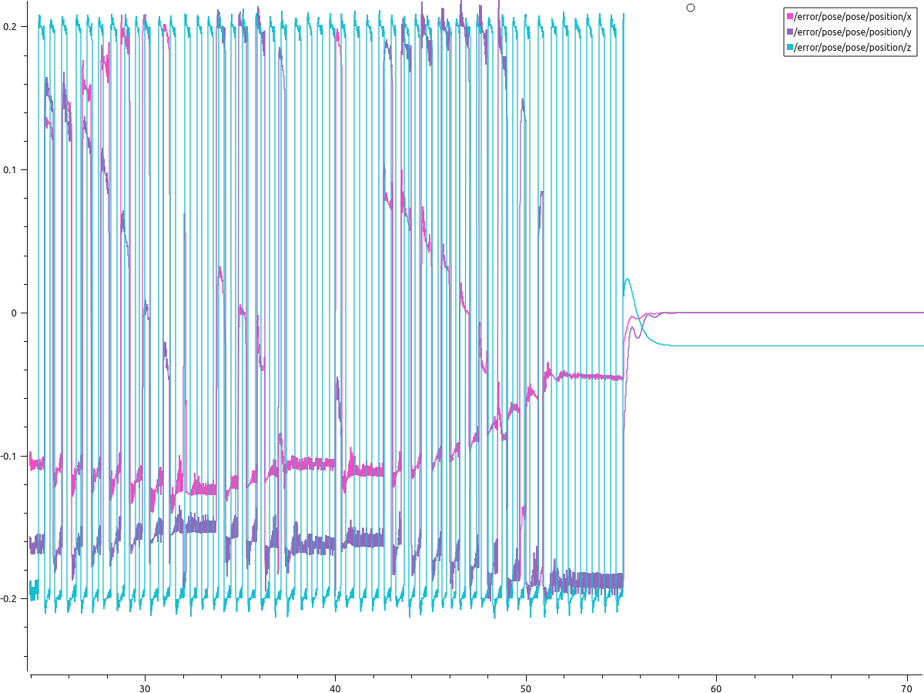
Simulation 2/4 Position Error

Slide 11
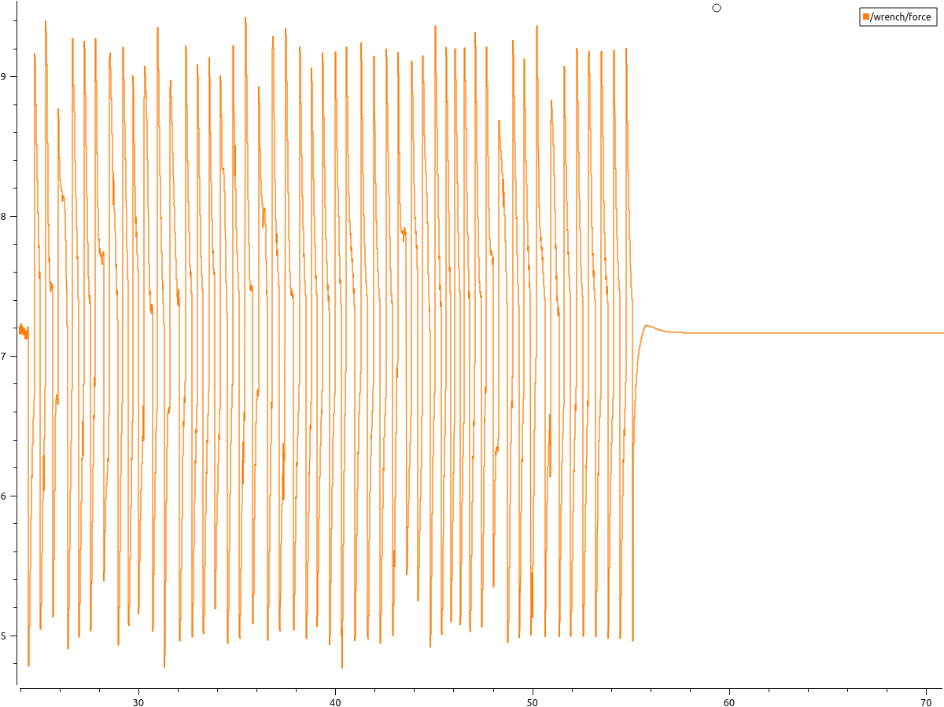
Simulation 3/4 Total thrust

Slide 12
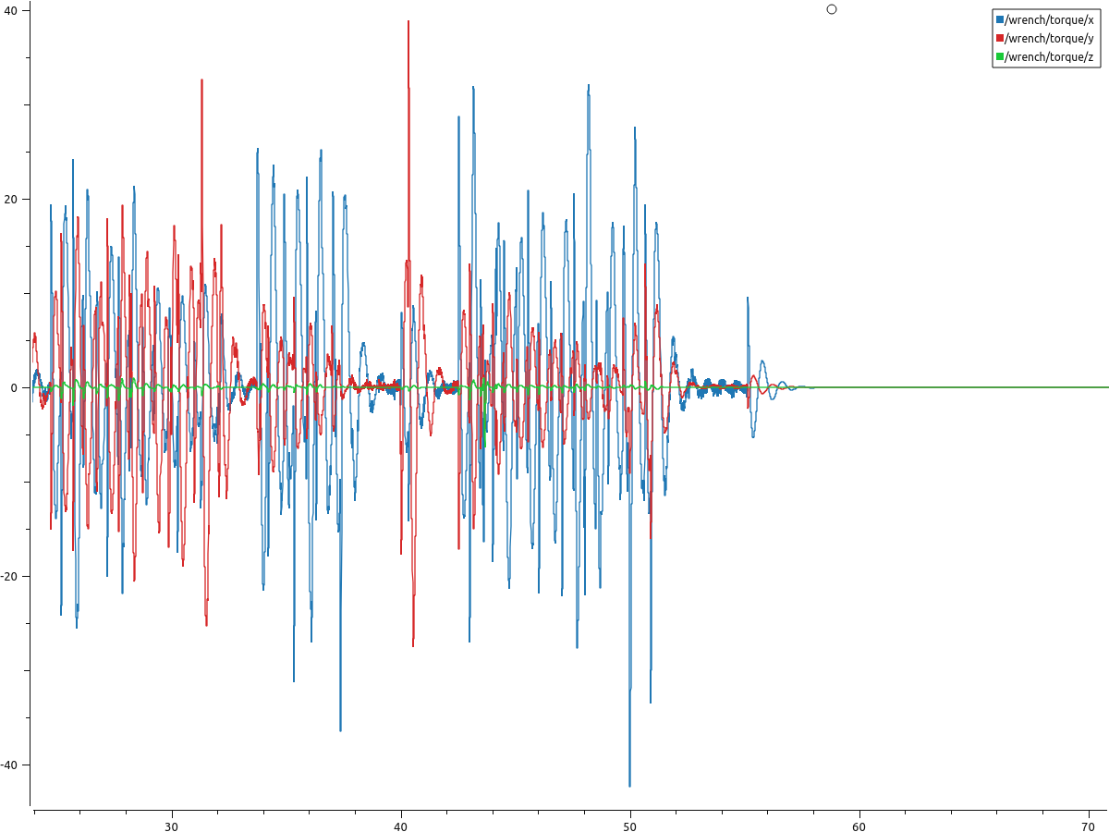
Simulation 4/4 Torques

